Slide 1



Optimising High-Performance Data Processing for
Carlist.my
Group 01:
Marcus Joey Sayner (A22EC0193)
Muhammad Luqman Hakim (A22EC0086)
Camily Tang Jia Lei (A22EC0039)
Goh Jing Yang (A22EC0052)

Slide 2


Introduction

Slide 3

Website chosen: Carlist.my
Listings for new, used, and reconditioned vehicles in Malaysia.
Rich source for automotive market analysis.

Slide 4
Objectives
To develop a web crawler to extract 100,000+ structured records from Carlist.my.
To clean, process, and store data in formats like CSV, JSON, or database.
To use multithreading and parallel processing to optimise crawling speed.
To compare system performance with and without optimisation (speed, CPU, memory, throughput).

Slide 5
Extracted Data
Attribute | Description
Car Name | The full name of the car, including model year, brand, and trim/version details
Car Brand | The manufacturer or brand of the vehicle
Car Model | The specific model of the car
Manufacture Year | The year in which the car was made
Body Type | The style or design of the car
Fuel Type | The type of fuel the car uses
Mileage | The total distance the car has been driven

Slide 6
Attribute | Description
Transmission | The type of transmission the car uses
Color | The colour of the car’s exterior
Price | The specific model of the car
Installment | The monthly payment of the car
Condition | The state of the car
Seat Capacity | The number of people the car can accommodate
Location | The geographic location where the car is being sold
Sales Channel | The type of seller or platform through which the car is being sold.

Slide 7
System Design & Architecture

Slide 8
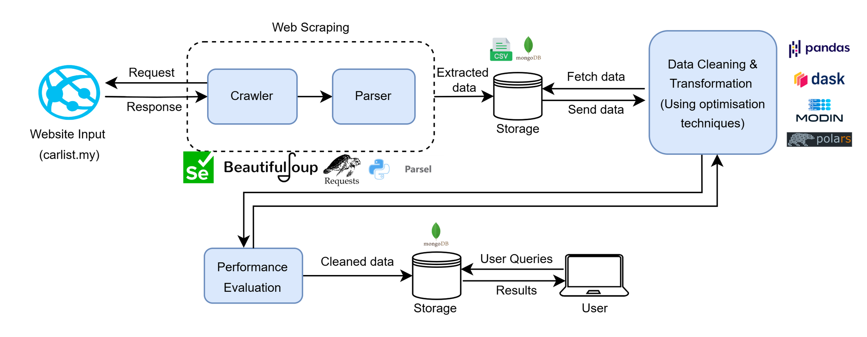

Slide 9
Tools & Frameworks Used
(Web Crawling & Scraping)
Name | Crawler | Scraper
Marcus Joey Sayner | httpx | parsel
Muhammad Luqman Hakim | urllib | Selectolax
Camily Tang Jia Lei | urllib | BeautifulSoup
Goh Jing Yang | requests | BeautifulSoup

Slide 10
Tools & Frameworks Used
(Big Data Processing)
Name | Library
Marcus Joey Sayner | Polars
Muhammad Luqman Hakim | Modin
Camily Tang Jia Lei | Pandas
Goh Jing Yang | Dask

Slide 11
Data Collection

Slide 12
Crawling Method
Used web scraping as the main crawling method.
Each member targeted different listing pages on Carlist.my.
Used different tools based on individual frameworks.
Crawlers were set with:
High page limits
Custom user-agent headers
Request delays to avoid overloading the server.

Slide 13
Records Collected
Each team member collected ~43,000 records through web scraping.
Combined dataset: 174,150 car listings.

Slide 14
Data Processing

Slide 15
Data Processing
Data processing is a key phase where raw data is cleaned, transformed, and structured for analysis. In this project, Pandas, Polars, Dask, and Modin were used—each offering unique strengths for handling datasets of different sizes efficiently.

Slide 16
Data Cleaning, Transformation & Formatting
1. Column Merging
Seat Capacity & Seating Capacity → Seat Capacity
Merged to remove redundancy
Nulls in primary column filled using the secondary
Redundant column dropped after merge
2. Column Removal
Dropped Column: URL
Contained long, non-analytical links
Removed to reduce clutter and focus on relevant data

Slide 17
Data Cleaning, Transformation & Formatting
3. String Cleaning & Formatting
Installment
Removed "RM", commas, and "/month"
Converted to numeric for analysis
Condition
Extracted clean labels from URLs (e.g., “Used”, “New”)
Removed suffixes for clarity
Sales Channel
Used regex to extract keywords like "Dealer" or "Sales Agent"
Cleaned or nullified unmatched entries
Mileage
Removed “K KM”, parsed ranges
Standardised into 5K-step bins (e.g., "10 - 15")

Slide 18
Data Cleaning, Transformation & Formatting
4. Null Handling
Dropped Rows with Missing Key Values
Columns checked: 'Body Type', 'Fuel Type', 'Mileage', 'Sales Channel', 'Seat Capacity'
Only complete rows are retained using .dropna()
5. Column Renaming (Add Units)
Improved Readability
‘Mileage’ → Mileage (K KM)
‘Price’ → Price (RM)
‘Installment’ → Installment (RM)

Slide 19
Data Cleaning, Transformation & Formatting
6. Duplicate Removal
Removed Exact Duplicate Rows
Used .drop_duplicates()
Retained meaningful semantic duplicates

Slide 20
Optimisation Techniques

Slide 21
Methods Used
Library | Explanation
Pandas | Operates in a single-threaded manner by default. Act as the control group.
Polars | Multi-threading to parallelise data operations. Built in Rust, providing faster performance and lower memory overhead.
Modin | Automatic parallelism using the Dask execution engines. Spreads DataFrame operations across all CPU cores.
Dask | Task-based parallelism and lazy computation graphs to break down large operations into smaller, manageable tasks.

Slide 22
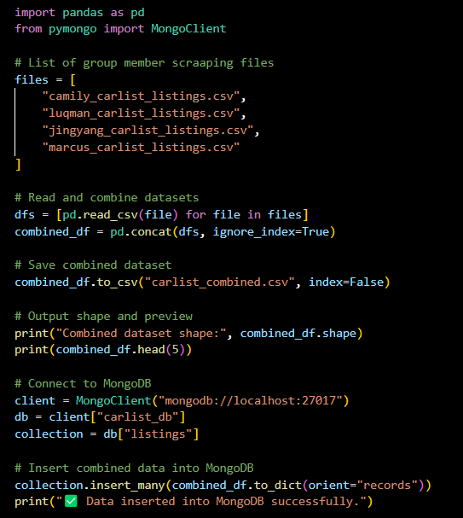
Code Overview
Combine Dataset

Slide 23
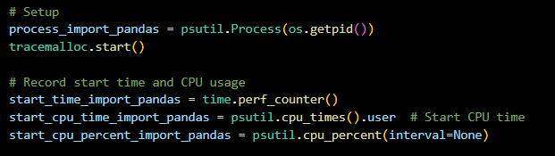
Code Overview
General Code

Slide 24
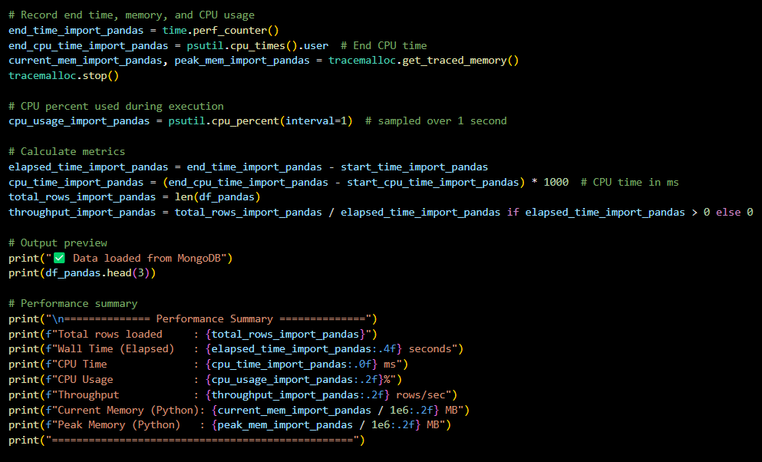
Code Overview
General Code

Slide 25
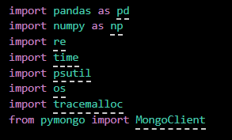
Code Overview
(Pandas)
Install & Import Libraries

Slide 26
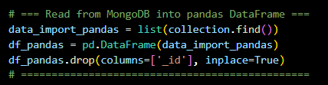
Code Overview
(Pandas)
Import Data

Slide 27
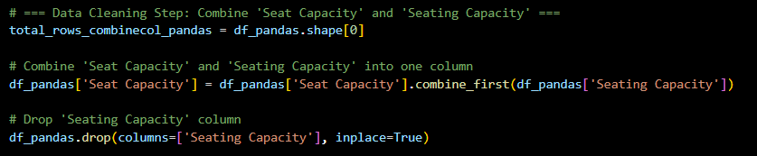
Code Overview
(Pandas)
Combine Columns

Slide 28

Code Overview
(Pandas)
Remove Unwanted Column(s)

Slide 29
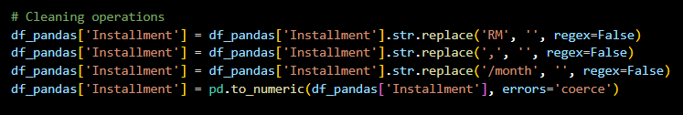
Code Overview
(Pandas)
String Cleaning and Formatting
(Clean Installment Column)

Slide 30
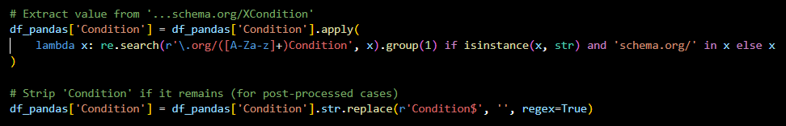
Code Overview
(Pandas)
String Cleaning and Formatting
(Extract Clean Values from Condition Column)

Slide 31
Code Overview
(Pandas)
String Cleaning and Formatting
(Clean Sales Channel)

Slide 32
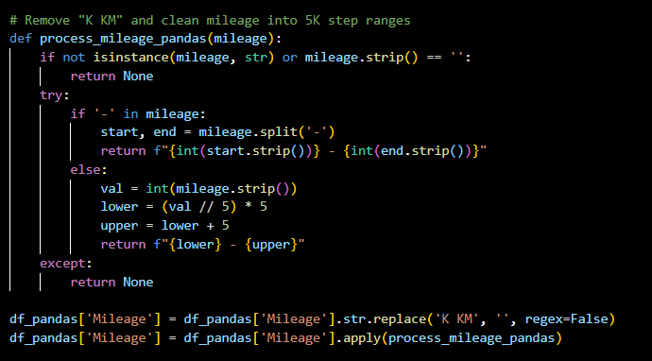
Code Overview
(Pandas)
String Cleaning and Formatting
(Clean Mileage)

Slide 33
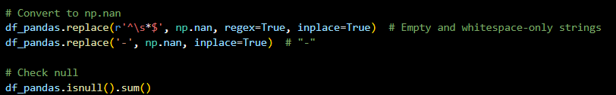
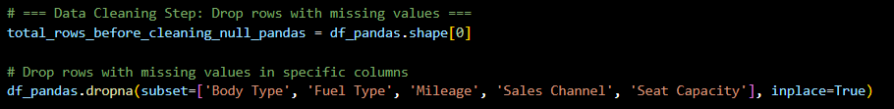
Code Overview
(Pandas)
Replace Null Values

Slide 34
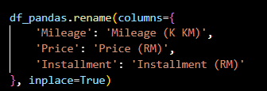
Code Overview
(Pandas)
Rename Columns

Slide 35


Code Overview
(Pandas)
Drop Duplicated Rows

Slide 36
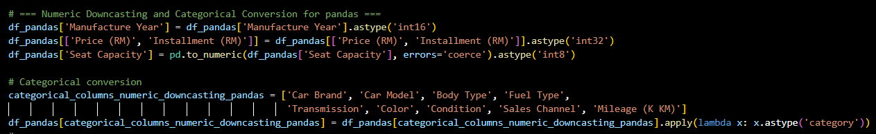
Code Overview
(Pandas)
Optimise Memory Usage by Using Efficient Data Types

Slide 37
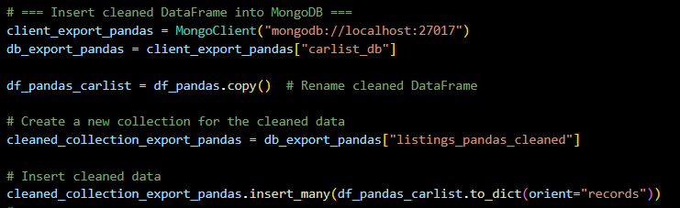
Code Overview
(Pandas)
Export Cleaned Data to MongoDB

Slide 38
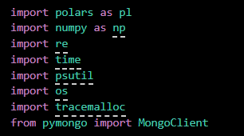
Code Overview
(Polars)
Install & Import Libraries

Slide 39
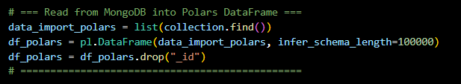
Code Overview
(Polars)
Import Data

Slide 40
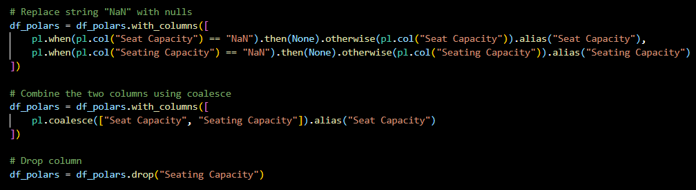
Code Overview
(Polars)
Combine Columns

Slide 41

Code Overview
(Polars)
Remove Unwanted Column(s)

Slide 42
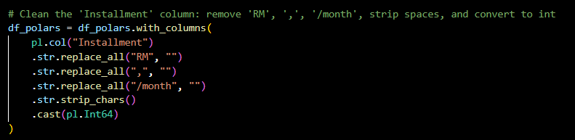
Code Overview
(Polars)
String Cleaning and Formatting
(Clean Installment Column)

Slide 43
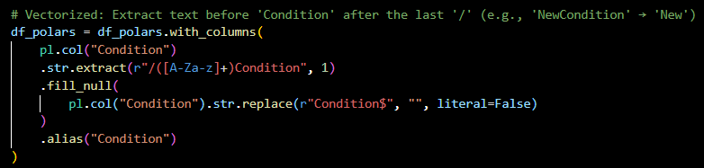
Code Overview
(Polars)
String Cleaning and Formatting
(Extract Clean Values from Condition Column)

Slide 44
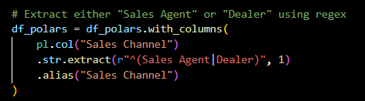
Code Overview
(Polars)
String Cleaning and Formatting
(Clean Sales Channel)

Slide 45
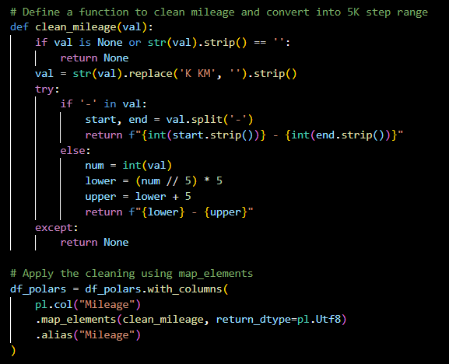
Code Overview
(Polars)
String Cleaning and Formatting
(Clean Mileage)

Slide 46
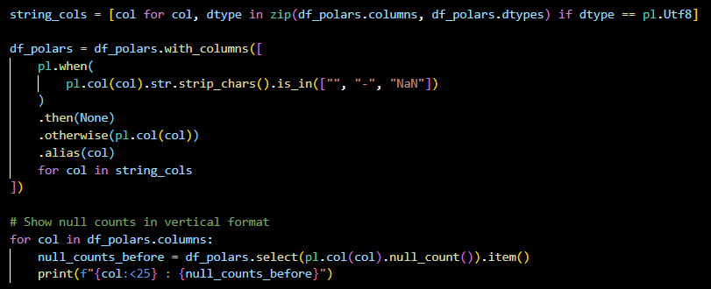
Code Overview
(Polars)
Replace Null Values

Slide 47
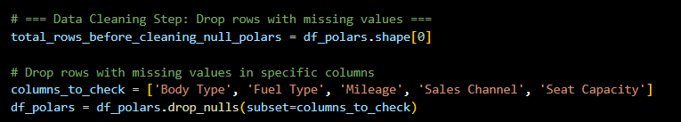
Code Overview
(Polars)
Replace Null Values

Slide 48
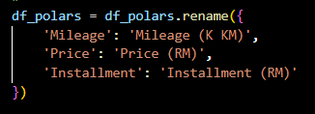
Code Overview
(Polars)
Rename Columns

Slide 49

Code Overview
(Polars)
Drop Duplicated Rows

Slide 50
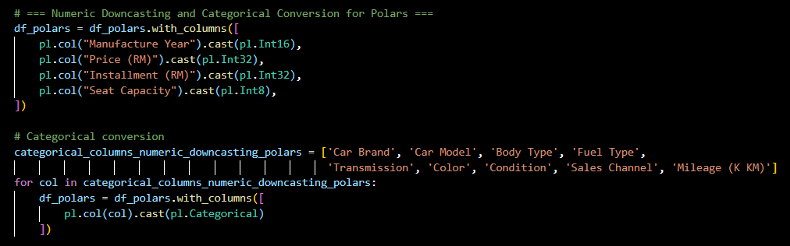
Code Overview
(Polars)
Optimise Memory Usage by Using Efficient Data Types

Slide 51
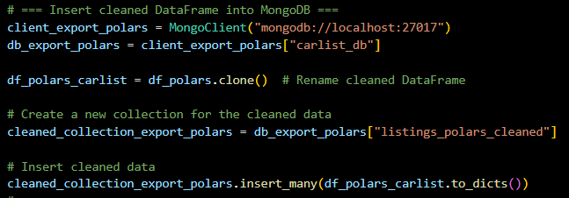
Code Overview
(Polars)
Export Cleaned Data to MongoDB

Slide 52
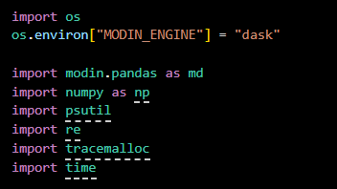
Code Overview
(Modin)
Install & Import Libraries

Slide 53
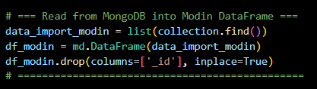
Code Overview
(Modin)
Import Data

Slide 54
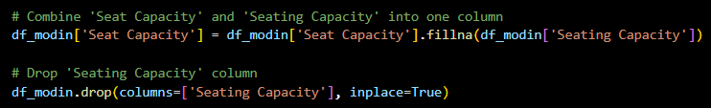
Code Overview
(Modin)
Combine Columns

Slide 55

Code Overview
(Modin)
Remove Unwanted Column(s)

Slide 56
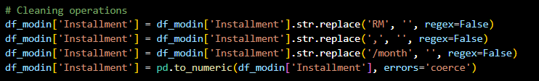
Code Overview
(Modin)
String Cleaning and Formatting
(Clean Installment Column)

Slide 57
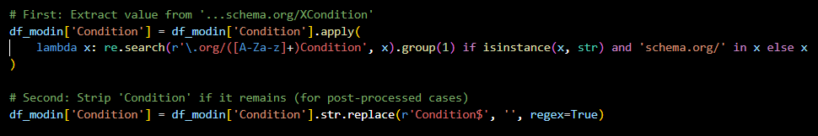
Code Overview
(Modin)
String Cleaning and Formatting
(Extract Clean Values from Condition Column)

Slide 58
Code Overview
(Modin)
String Cleaning and Formatting
(Clean Sales Channel)

Slide 59
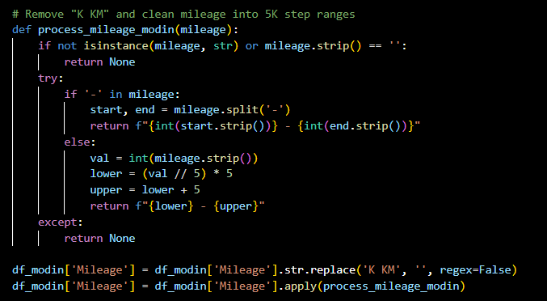
Code Overview
(Modin)
String Cleaning and Formatting
(Clean Mileage)

Slide 60
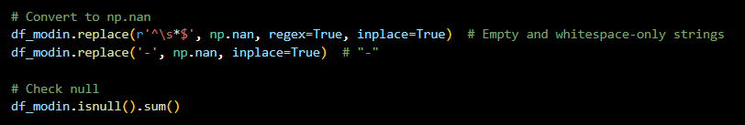
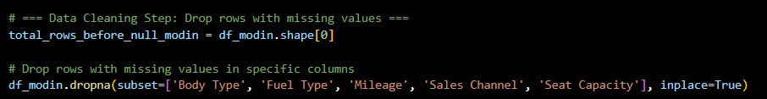
Code Overview
(Modin)
Replace Null Values

Slide 61
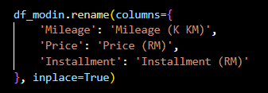
Code Overview
(Modin)
Rename Columns

Slide 62


Code Overview
(Modin)
Drop Duplicated Rows

Slide 63
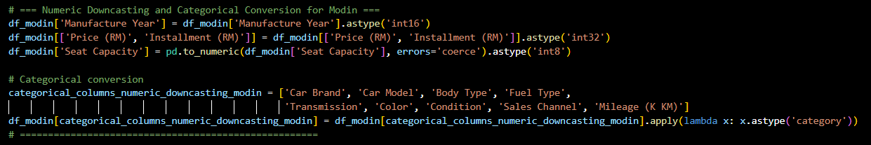
Code Overview
(Modin)
Optimise Memory Usage by Using Efficient Data Types

Slide 64
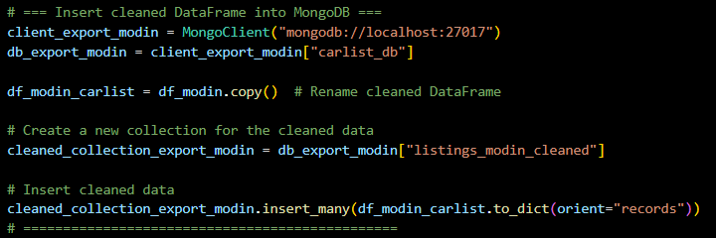
Code Overview
(Modin)
Export Cleaned Data to MongoDB

Slide 65
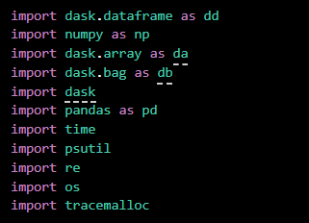
Code Overview
(Dask)
Install & Import Libraries

Slide 66
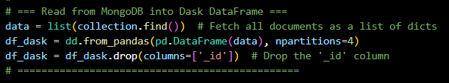
Code Overview
(Dask)
Import Data

Slide 67
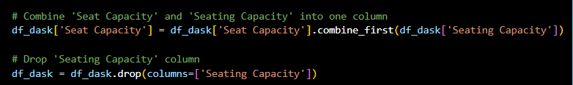
Code Overview
(Dask)
Combine Columns

Slide 68

Code Overview
(Dask)
Remove Unwanted Column(s)

Slide 69
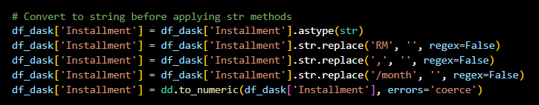
Code Overview
(Dask)
String Cleaning and Formatting
(Clean Installment Column)

Slide 70
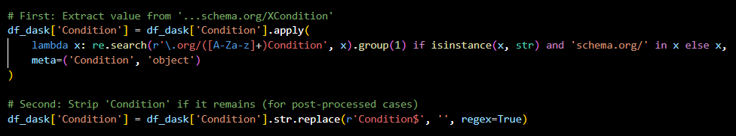
Code Overview
(Dask)
String Cleaning and Formatting
(Extract Clean Values from Condition Column)

Slide 71
Code Overview
(Dask)
String Cleaning and Formatting
(Clean Sales Channel)

Slide 72
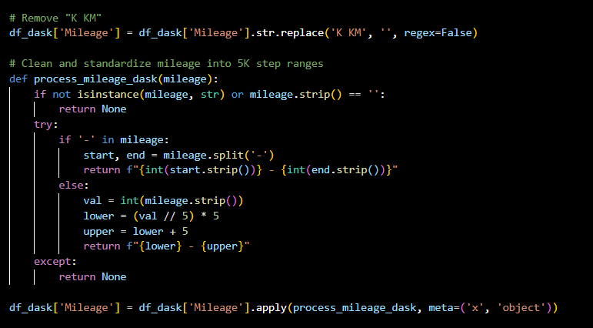
Code Overview
(Dask)
String Cleaning and Formatting
(Clean Mileage)

Slide 73
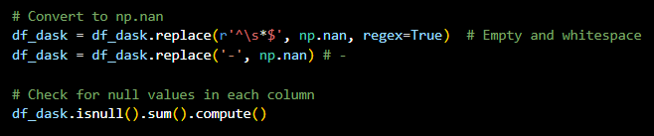
Code Overview
(Dask)
Replace Null Values

Slide 74
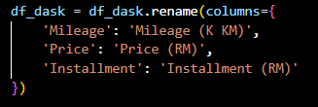
Code Overview
(Dask)
Rename Columns

Slide 75
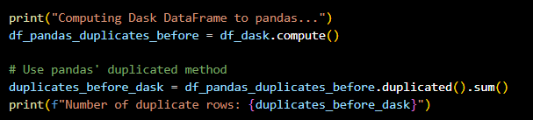

Code Overview
(Dask)
Drop Duplicated Rows

Slide 76
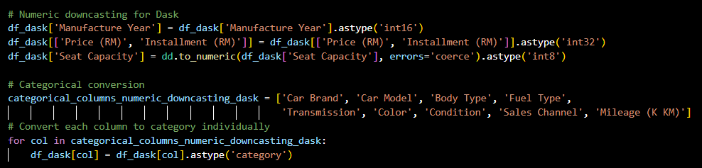
Code Overview
(Dask)
Optimise Memory Usage by Using Efficient Data Types

Slide 77
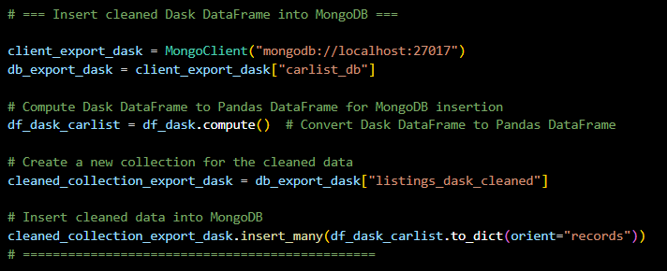
Code Overview
(Dask)
Export Cleaned Data to MongoDB

Slide 78
Performance Evaluation

Slide 79
Performance Evaluation Goals
Key objectives:
Reduce overall processing time
Lower peak memory consumption
Improve CPU utilisation
Increase records-per-minute throughput

Slide 80
Before vs After Optimisation
Processing Time:
Up to 5× faster with Polars vs. Pandas
2–3× improvement using Modin/Dask
Memory Usage:
30–40% reduction in Polars
~20% in Modin; depends on chunk size
CPU Utilisation:
Pandas under-utilises CPUs (< 30% avg.)
Polars/Modin/Dask push towards 80–100%
Throughput (records/min):
Pandas: ~50 K rec/min
Polars: 200 K+ rec/min
Modin/Dask: 100–150 K rec/min

Slide 81
Time, Memory, CPU Usage, Throughput
Elapsed Time (Wall Time): The real-world time taken to complete the task from start to finish.
CPU Time: The actual CPU processing time consumed, measured in milliseconds.
CPU Usage (%): The intensity of CPU usage during code execution.
Throughput: The number of records processed per second, calculated as total rows divided by elapsed time.
Current Memory Usage: The amount of memory in use at the end of execution.
Peak Memory Usage: The highest amount of memory used at any point during execution.

Slide 82
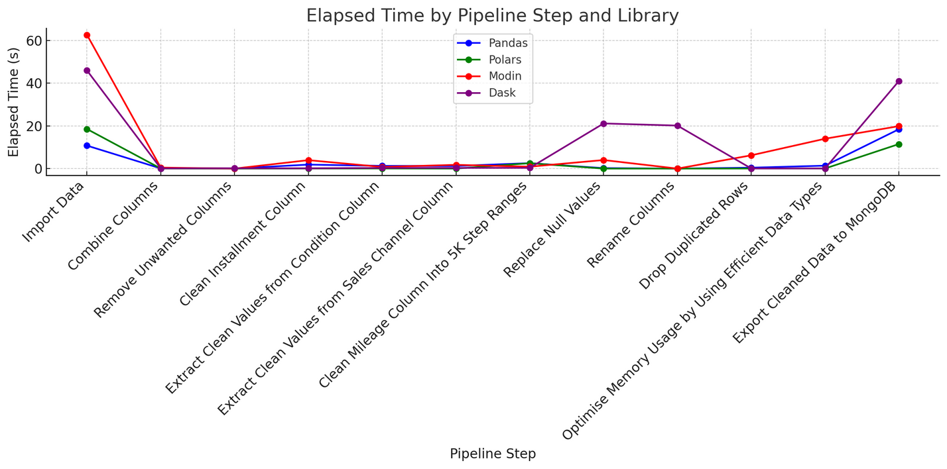
Charts and Graphs

Slide 83

Charts and Graphs

Slide 84

Charts and Graphs

Slide 85

Charts and Graphs

Slide 86

Charts and Graphs

Slide 87

Charts and Graphs

Slide 88
Challenges & Limitations

Slide 89
Website Restrictions and Limited Data Access
Script Stability and VSCode Freezing
Environment and Library Compatibility Issues
Scraping large datasets caused the script to stop unexpectedly, leading to performance issues and freezing in VSCode, which disrupted progress.
Robots.txt restrictions and poor pagination limited access to data, making it difficult or unethical to scrape certain content or collect large datasets.
Libraries like Playwright and Selenium faced installation or runtime issues in Google Colab due to its limited support for headless browsers and resource constraints.

Slide 90
Reasons of Challenges & Limitations

Slide 91
High Resource Usage in VSCode
Website Restrictions and Dynamic Content
Limitations of Google Colab Environment
Running heavy scraping scripts in VSCode’s terminal caused high memory and CPU usage, making the IDE unresponsive due to excessive real-time output.
Robots.txt limitations, dynamic content loading, and intentional design choices restricted data access, making scraping difficult or unethical.
Colab's short session durations, limited RAM, and restricted system-level access made it unsuitable for long-running, resource-heavy scraping tasks.

Slide 92
Solutions

Slide 93
Optimized Execution in VSCode
Improved Compatibility with Google Colab
Ethical and Efficient Scraping Practices
The scraping was split into smaller batches with delays and intermediate data saving, reducing memory load and preventing VSCode from freezing.
Robots.txt was respected, dynamic content was accessed using tools like Playwright, and requests were spaced out to avoid server strain and detection.
Lightweight libraries like httpx and Selectolax replaced heavier tools, while data was processed in batches and stored externally to manage Colab’s resource limits.

Slide 94
Conclusion & Future Work

Slide 95

Summary of Findings
Polars outperforms others with minimal CPU (6–16%) and memory use, handling up to 150 million rows/sec, thanks to its Rust-based, multi-threaded backend.
Polars: Fastest and Most Efficient
Although slower for heavy operations, Pandas remains a dependable choice for simple, single-machine ETL jobs with moderate CPU (7–20%) and memory usage.
Pandas: Reliable for Small-Scale Tasks
These tools are optimized for distributed processing but suffer from longer startup times and higher CPU/memory usage on single machines, making them less efficient for small-scale tasks.
Modin and Dask: Scalable but Resource-Heavy
All tools begin around 420–450 MB, but Polars maintains the lowest additional memory through streaming. In contrast, Dask shows the highest variation, peaking at 800 MB during loading.
Memory Usage During ETL

Slide 96
Improvement for Future Works
Transitioning to local machines with sufficient resources or cloud platforms like AWS or Azure ensures better tool compatibility and runtime stability, especially for headless browser automation.
Use of Scalable Computing Environments
Implementing structured error handling, persistent logging, and breaking tasks into smaller units increases fault tolerance and simplifies debugging during large-scale scraping.
Robust Error Handling and Task Management
Respecting robots.txt, using official APIs, and seeking data-sharing agreements help maintain ethical standards and avoid legal issues in web scraping.
Ethical and Legal Compliance
Using streaming, temporary storage, and optimized formats like Parquet—alongside performance-focused libraries like Polars—improves memory efficiency and supports large-scale ETL workflows.
Efficient Data Processing and Memory Management

Slide 97

Thank
you!

